Slide 1





FINANCE & SUPPLY CHAIN ANALYTICS

Slide 2


TABLE OF CONTENTS
About AtliQ
Business Model
Problem Statement
Project Overview
Schemas
Reports
Conclusion

Slide 3
ATLIQ HARDWARE AND BUSINESS MODEL
AtliQ Hardware is a distinguished global leader in electronics manufacturing, specializing in the production and distribution of an extensive range of high-quality hardware products. Our offerings include personal computers, printers, mice and a variety of other computer peripherals, serving the diverse needs of customers worldwide.

Slide 4

PROBLEM STATEMENT
AtliQ Hardware is currently facing performance challenges due to the increasing size and complexity of its Excel files. To address this, the company has formed a dedicated team of data analysts to leverage MySQL for extracting valuable insights and enhancing operational efficiency

Slide 5
PROBLEM OVERVIEW
The Scope of this project entails conduction an in-depth analysis of the dataset provided by AtliQ Hardware. The primary goal is to derive actionable insights regarding sales performance, market dynamics, customer behavior, and to forecast supply chain trends

Slide 6
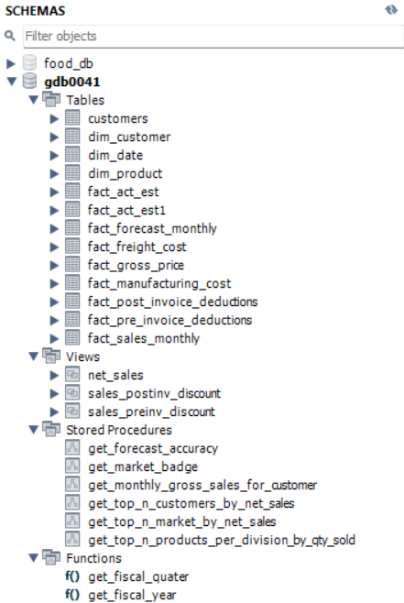

SCHEMAS

Slide 7

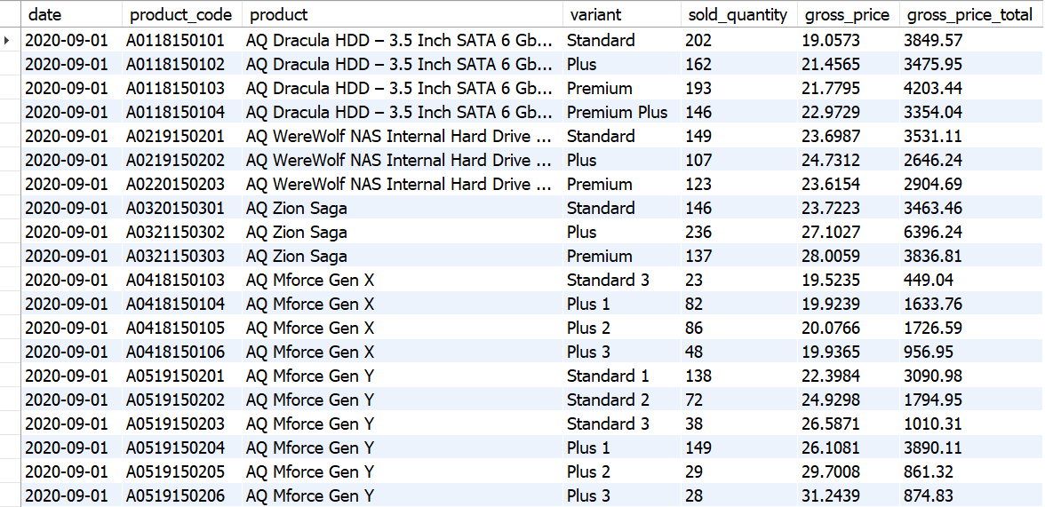
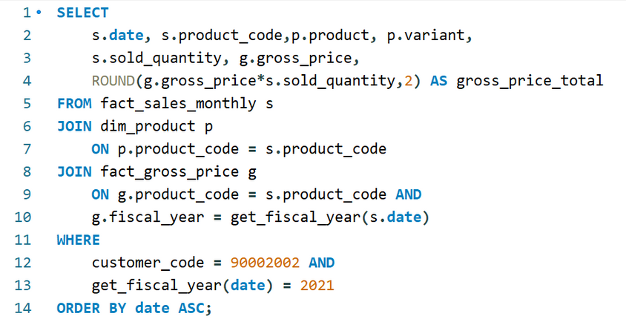
CROMA SALES REPORT
Generated a report detailing the individual product sales for Croma India customer throughout the fiscal year 2021

Slide 8
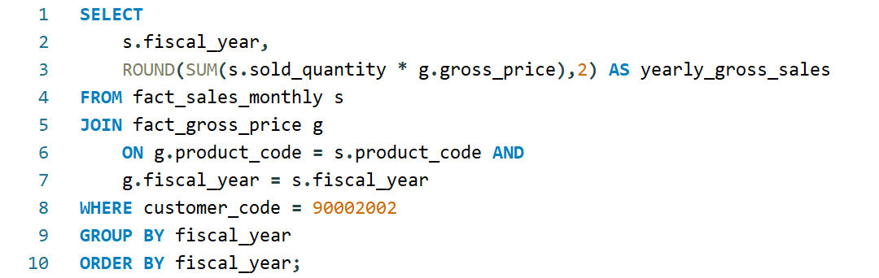
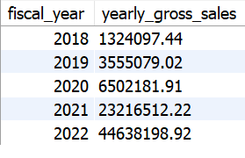
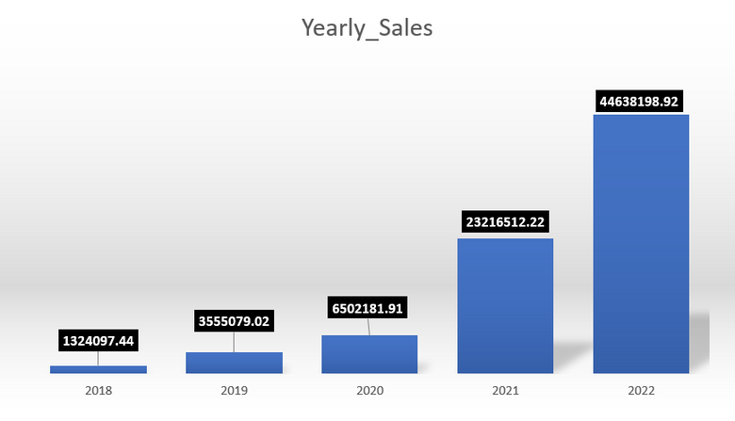
CROMA GROSS SALES REPORT YEARLY
Generated a yearly report for Croma India where there are two columns.
Fiscal Year
Total Gross Sales amount

Slide 9
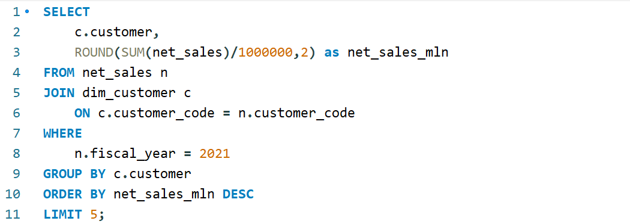
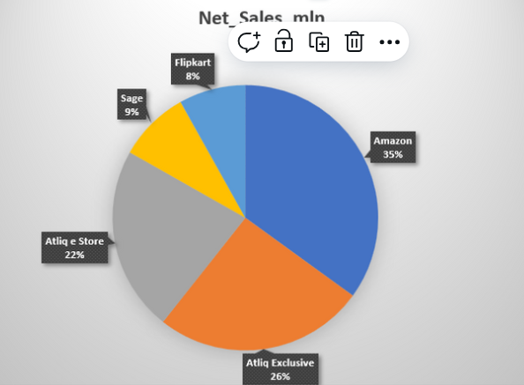
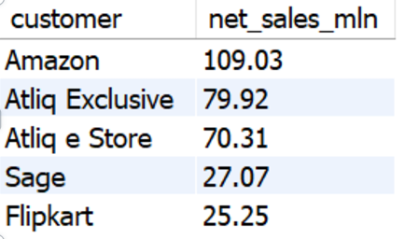
TOP 5 CUSTOMERS
Generated a report getting Top 5 Customers by Net Sales in Fiscal Year 2021.

Slide 10
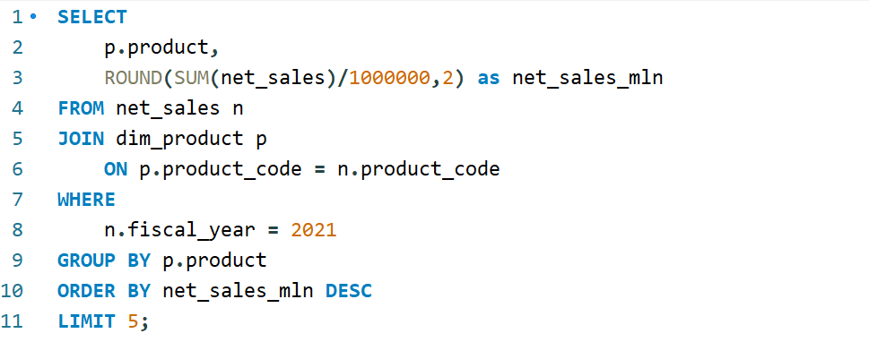
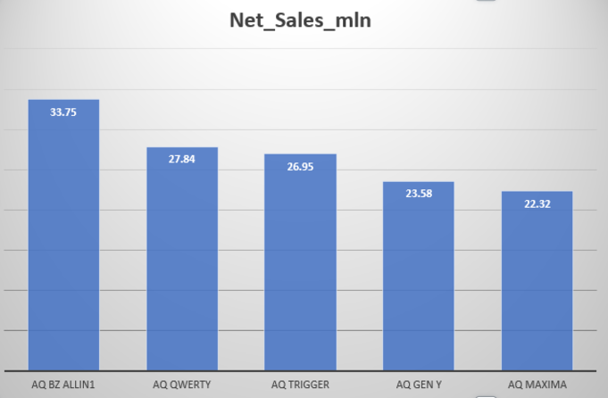
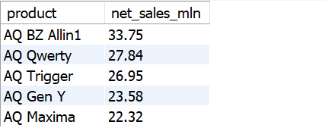
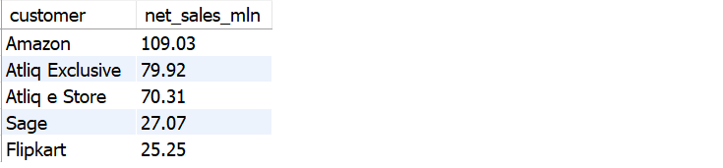
TOP 5 PRODUCTS
Generated a report getting Top 5 Products by Net Sales in Fiscal Year 2021

Slide 11
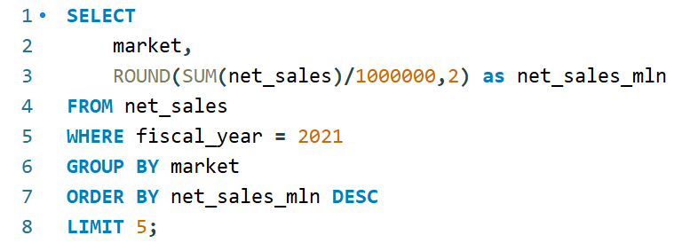
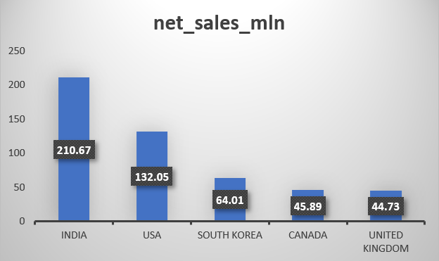
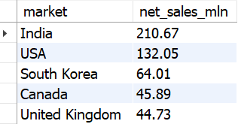
TOP 5 MARKETS
Generated a report getting Top 5 markets
by Net Sales in Fiscal Year 2021

Slide 12
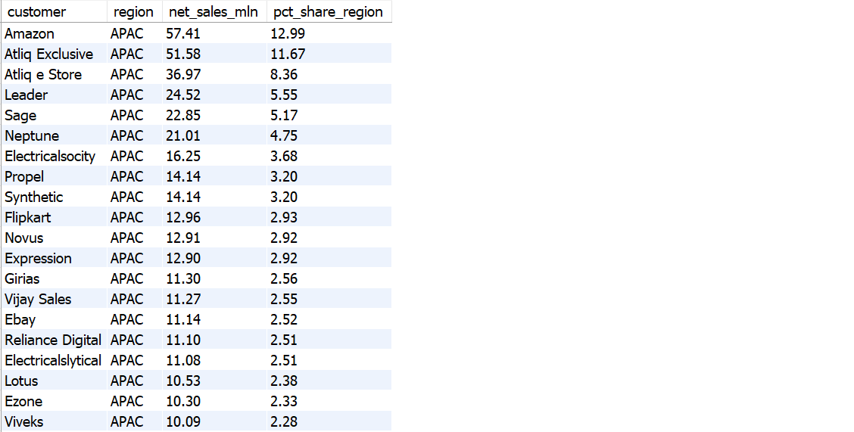
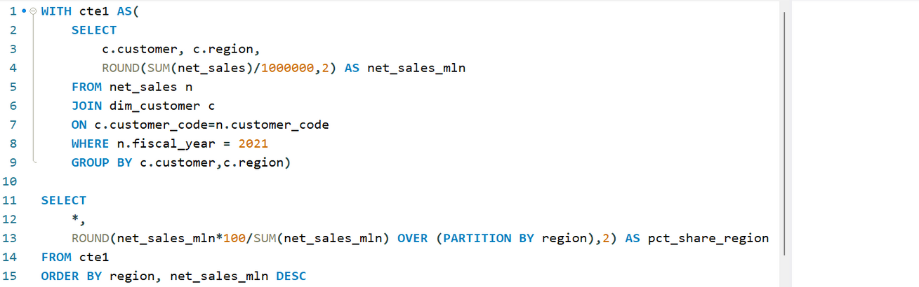
NET SALES% REPORT
Generated a Net Sales% report of Customers in different regions

Slide 13
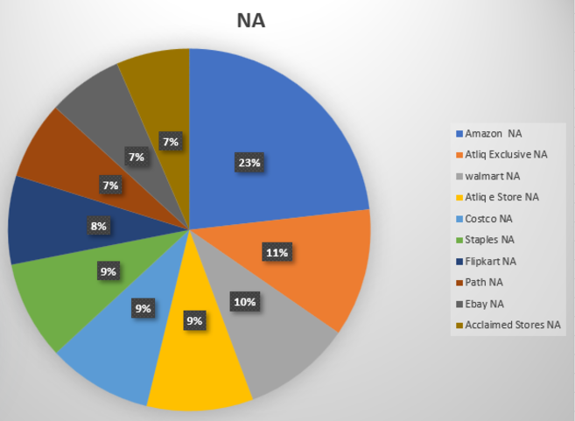
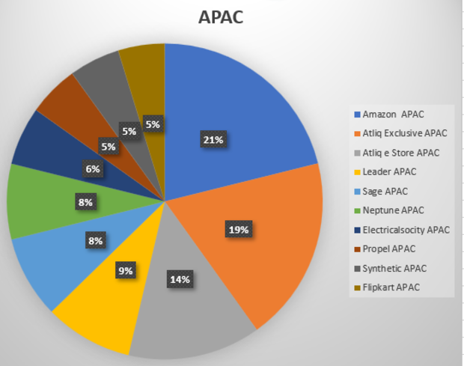
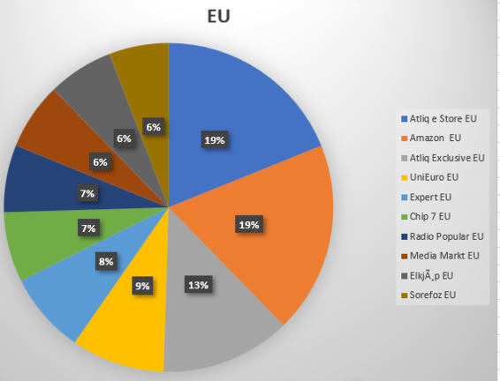
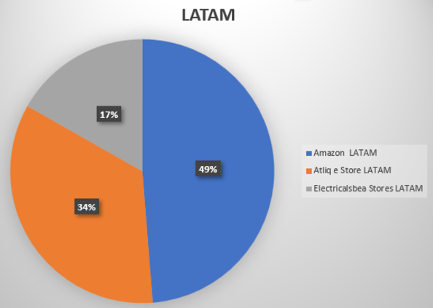
MARKET SHARE %
It shows Top Customers in different Regions

Slide 14
CONCLUSION
AtliQ Hardware achieved record sales in 2022.
India was the largest market in 2021 with sales of $210.67M
Amazon generated the highest Net Sales in 2021 with $109.03M
The AQ BZ All-in-One was the top-selling product in 2021 with the sales of $33.75M
Amazon captures the top market share% in APAX, LATAM & NA regions.
AtliQ estore topped the chart in EU region.

Slide 15


THANK YOU
Pawan-Yadav-Data
To everyone who is present here

